Slide 1
Integrated Circuits. CMOS
Oleg Ladin
23 September 2019

Slide 2
Course materials
Lectures: https://mipt-ilab.github.io/mipt-mips/
GitHub: https://github.com/MIPT-ILab/mipt-mips/
Form for participants (link) – please fill it

Slide 3
Layers of Abstraction in Computer Science (CS)
Application
Algorithms
Programming Language
Operating System
Instruction Set Architecture
Microarchitecture
More about voltages, wires and transistors…
Gates/Register-Transfer Level (RTL)
Circuits
Topics of
this lecture
Less about electrons, semiconductors…
Physics

Slide 4
Semiconductors

Slide 5
Why Transistor?
Transistors are the fundamental building blocks for all digital circuits
The main advantage of transistors over other devices (i.e., vacuum tubes) is that they are:
Very small (~ 10nm)
Reliable (the 1946 ENIAC, with over 17,000 vacuum tubes, had a tube failure on average every two days)
Power efficient (almost don’t consume energy when the state is not changed)
Cheap (production cost of a processor is about several dollars, but it contains billions of transistors)

Slide 6
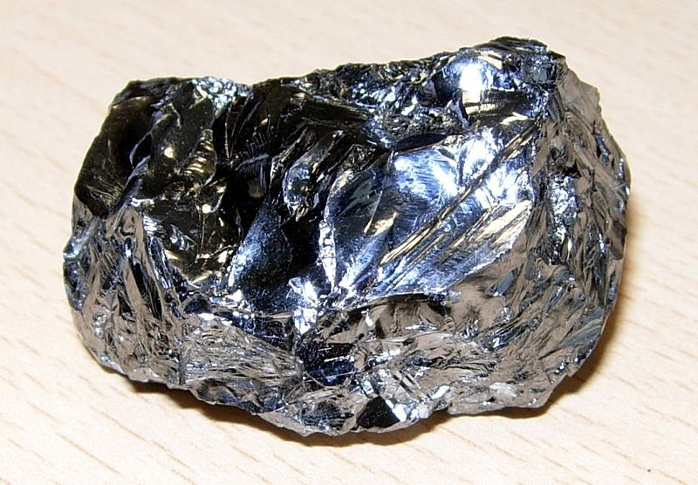
Silicon
Silicon (Si) is a chemical element with atomic number 14
It has four electrons in the outermost shell available for covalent chemical bonding:
$${1s}^{2}$$
$${2s}^{2}$$
$${2p}^{6}$$
$${3s}^{1}$$
$${3p}^{3}$$
Si (+14)
↑↓
↑↓
↑↓
↑↓
↑↓
↑
↑
↑
↑
Stick model of a silicon atom
Purified silicon
Planar structure of silicon crystal

Slide 7
Conduction properties
Pure silicon is a semiconductor: is doesn’t conduct strong electrical current, because it has few free charge carriers
Spontaneous electron-ion par creation
Silicon dioxide (SiO₂) is an insulator: sand doesn’t conduct any electrical current.

Slide 8
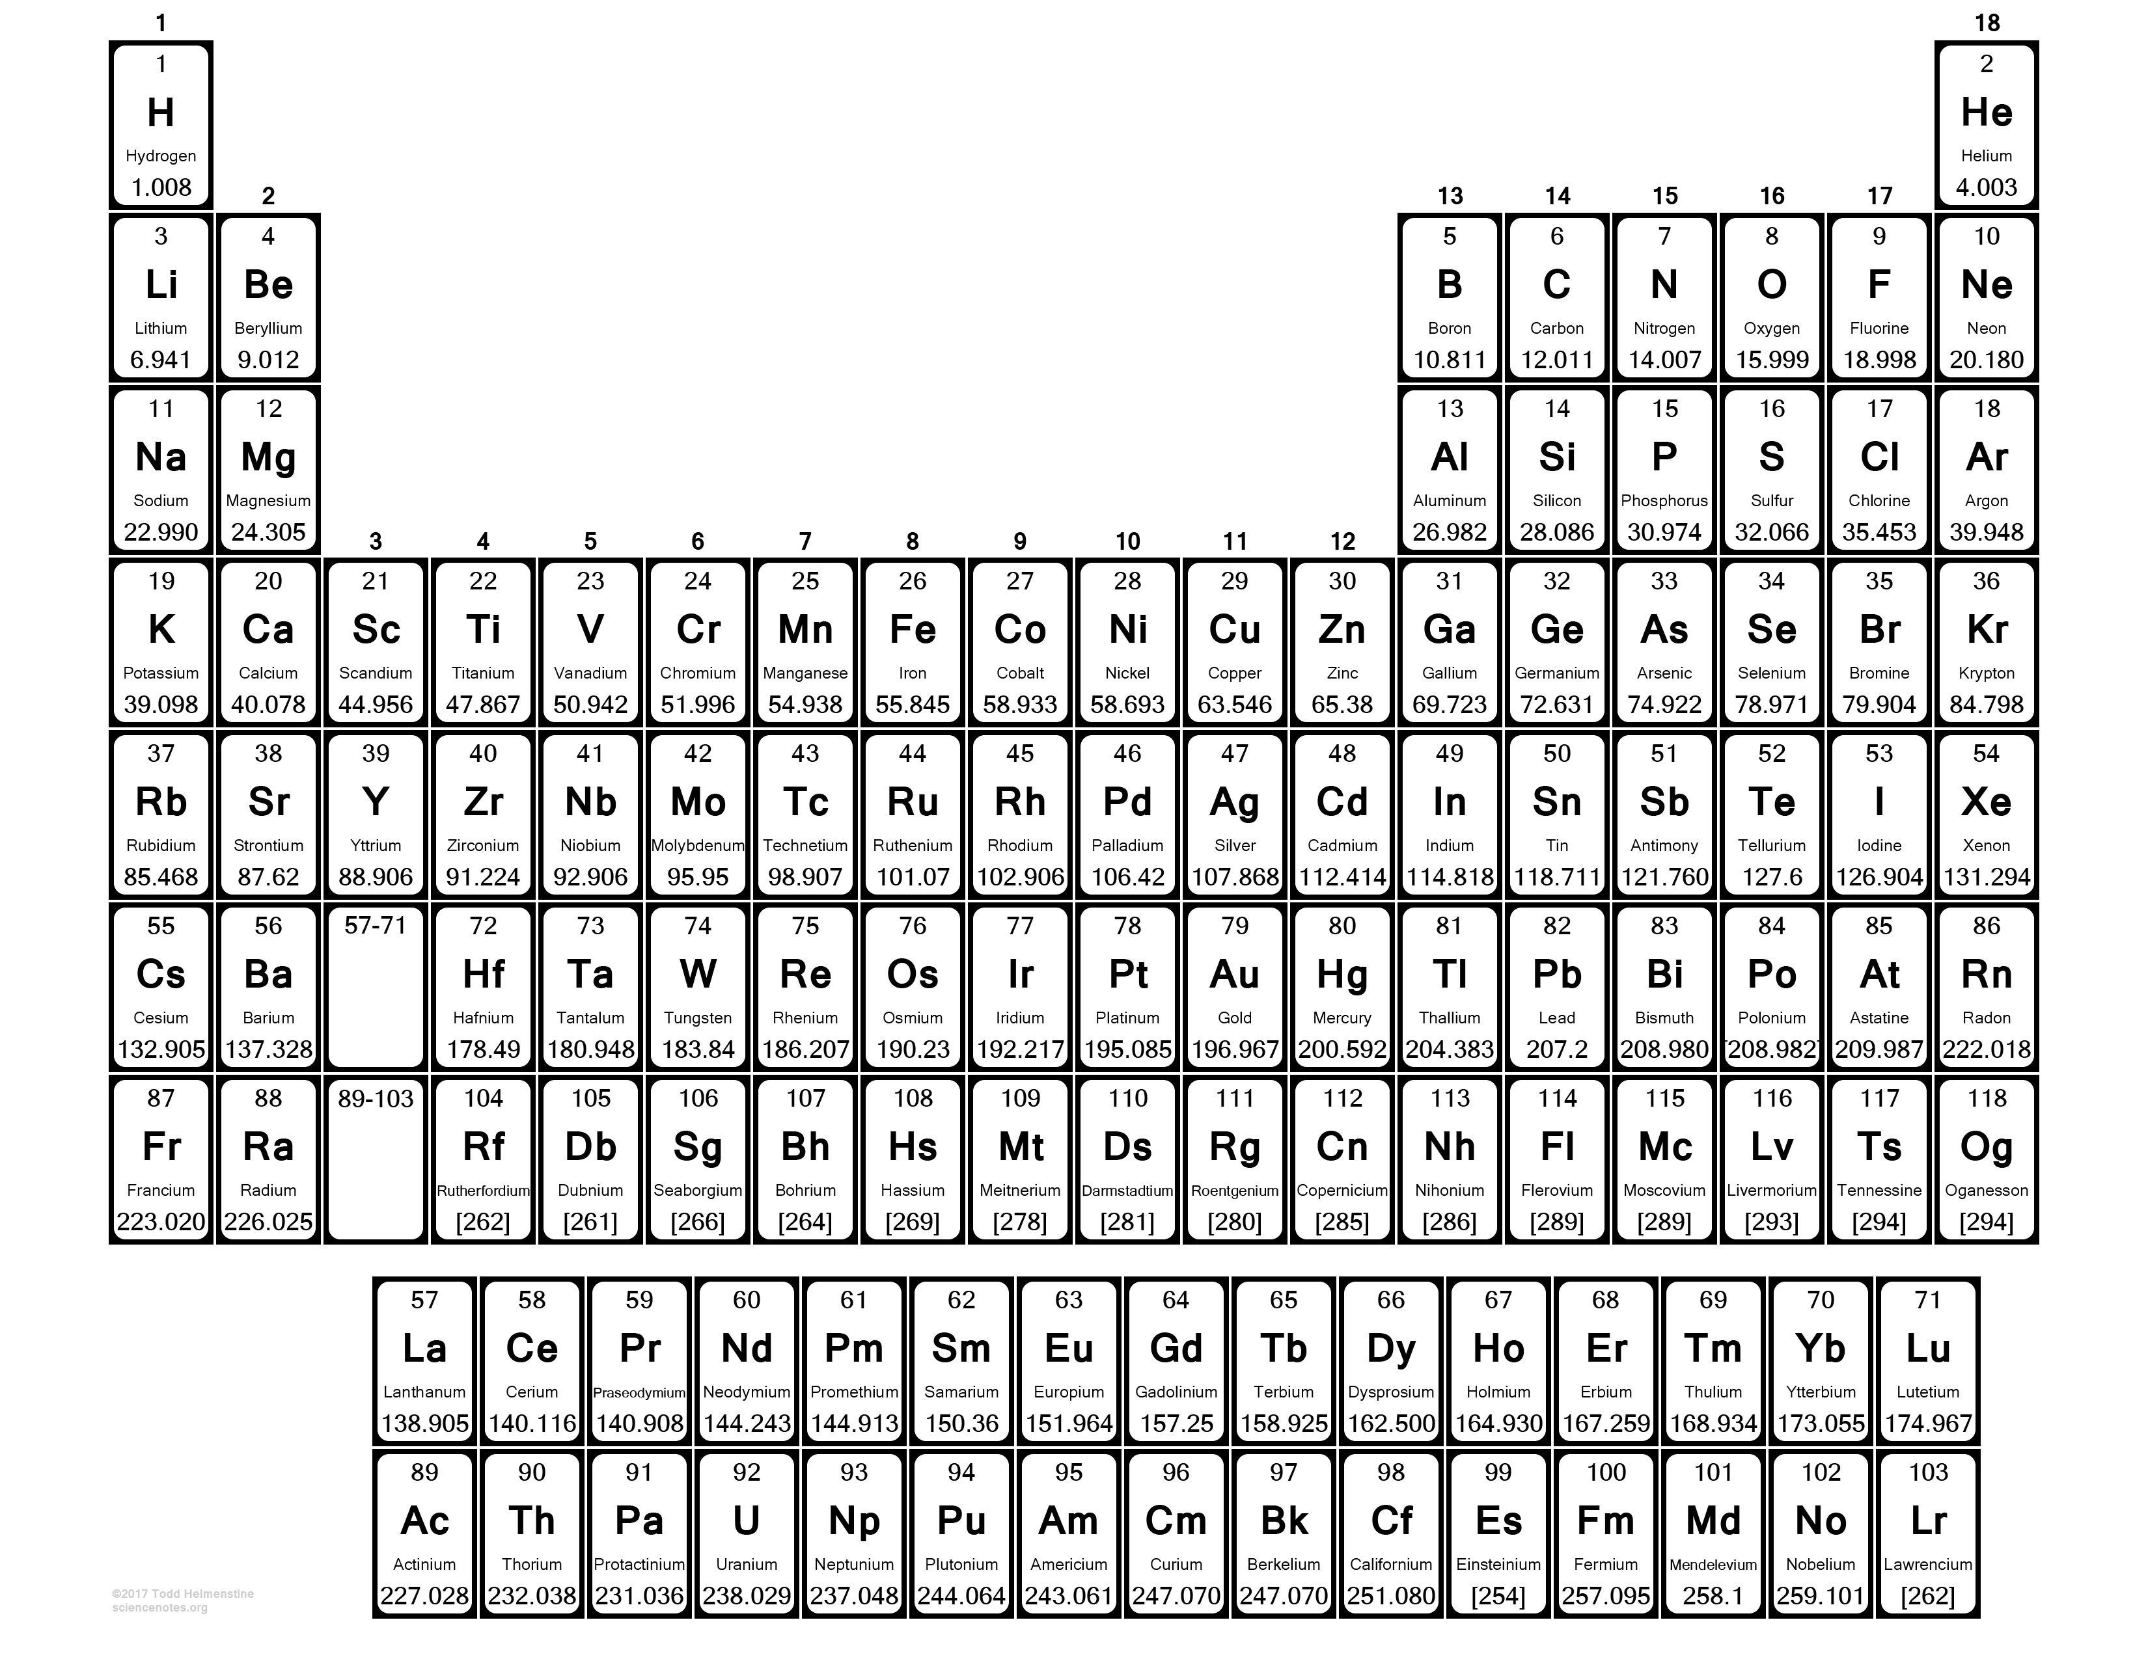


N-type Doping
$${1s}^{2}$$
$${2s}^{2}$$
$${2p}^{6}$$
$${3s}^{1}$$
$${3p}^{3}$$
P
Si (+14)
-
+
↑↓
↑↓
↑↓
↑↓
↑↓
↑
↑
↑
↑
$${1s}^{2}$$
$${2s}^{2}$$
$${2p}^{6}$$
$${3s}^{2}$$
$${3p}^{3}$$
P (+15)
↑↓
↑↓
↑↓
↑↓
↑↓
↑↓
↑
↑
↑
P
-
+
P
+
-
N-type semiconductor (Si doped by P atoms)

Slide 9

P-type Doping
+
$${1s}^{2}$$
$${2s}^{2}$$
$${2p}^{6}$$
$${3s}^{1}$$
$${3p}^{3}$$
Al
-
Si (+14)
-
↑↓
↑↓
↑↓
↑↓
↑↓
↑
↑
↑
↑
$${1s}^{2}$$
$${2s}^{2}$$
$${2p}^{6}$$
$${3s}^{1}$$
$${3p}^{2}$$
Al (+13)
↑↓
↑↓
↑↓
↑↓
↑↓
↑
↑
↑
Al
Al
P-type semiconductor (Si doped by Al atoms)

Slide 10
“Holes” concepts
An electron hole is the conceptual and mathematical opposite of an electron. The concept describes the lack of an electron at a position where one could exist in an atom or atomic lattice.
15-puzzle game example:
1
5
12
10
14
9
3
15
11
7
8
4
13
2
6

Slide 11
MOSFET

Slide 12

Abstracting From Physics
X
$$∇∙D=ρ$$
$$∇∙B=0$$
$$∇×E=−\frac{∂B}{∂t}$$
$$∇×H=j+\frac{∂D}{∂t}$$
Real physical circuits deal with physical properties, such as voltages and currents
Digital circuits use the abstractions of 0 and 1 to represent the presence or absence of these physical properties (signals) rather than a continuous range
voltage
It could not be a stable state: should not occur in the circuit except during transitions from one state to he other
5 V
Logic 1
3.5 V
Weak 1
undefined
1.5 V
Weak 0
Logic 0
0 V
Boolean algebra describes two-stated systems

Slide 13
MOSFET
The metal-oxide-semiconductor field-effect transistor (MOSFET) acts as a voltage-controlled switch with three terminals: source, drain, and gate
The gate controls whether current can pass from source to drain or not
There are two variations of the MOSFET: the n-channel (this slide) and the p-channel
Source
Gate
Drain
Metal
Oxide layer
N-type semiconductor
-
-
-
P-type semiconductor
-
-
-
+
+
+
+

Slide 14
Diffusion process
Holes and electrons diffuse into the n-type and p-type semiconductors correspondently
The diffusion process creates the balancing field (Ed) that prevents deeper diffusion
Source
Gate
Drain
Ed
+
+
Ed
Ed
+
+
Ed
-
-
-
-
+
+
+
+
-
-
-
-
-
-
-
-
Ed
Ed

Slide 15
Closed State for N-type MOSFET
For N-type MOSFET if the gate is not connected (high-impedance state, Z) or equal to 0 there is not current through the drain
One of n-p junction is always closed
Source
Gate
Drain
0
0/Z
Z
Ed
Ecc
This p-n junction is closed: its field balances the field of the supply
No current through this p-n junction

Slide 16
Open State for N-type MOSFET
For N-type MOSFET if the gate is equal to V_{t} (Logic 1) then the transistor is open: the source value pass to the drain
The current passes though the small channel created by the gate field (more detailed explanation is out of scope of our course)
Source
Gate
Drain
0
V_{t} (==1)
0
+
+
+
+
-
-
Eg
N-type channel with free conductors (electrons)

Slide 17
N-type MOSFET logical scheme
Drain
Gate | State | Input (Source) | Output (Drain)
1 | On (conduct) | 0 | 0
 |  | 1 | weak 1
0 (any other value than 1) | Off (not conduct) | any | Z
Gate
Source
When the gate is “closed”, transistor does not conduct
When the gate is “open”, transistor can conduct “0”
When the gate is “open”, transistor conducts “1”, but:
Source
Gate
Drain
1
1
Voltage between source and gate is 0, so p-n is not fully “open” (details are beyond the scope of our course)

Slide 18
N and P-type MOSFET
N-type MOSFET:
Drain
Gate | State | Input (Source) | Output (Drain)
1 | On (conduct) | 0 | 0
 |  | 1 | weak 1
0 (any other value than 1) | Off (not conduct) | any | Z
Gate
Source
P-type MOSFET (similar to N-type, but all is inverted):
Source
Gate | State | Input (Source) | Output (Drain)
0 | On (conduct) | 0 | weak 0
 |  | 1 | 1
1 (any other value than 0) | Off (not conduct) | any | Z
Gate
Drain

Slide 19
Invertor
!A
Input
Output
Input | Output
0 | Z
1 | 0
Input | Output
0 | 1
1 | Z
Input | Output
0 | 1
1 | 0
Vcc
Vcc
1
Source
1
Gate
Input
Z
Output
Drain
Drain
1
0
Gate
0
Source
0
The bottom part
The top part
The full scheme

Slide 20
CMOS Circuits
Complementary metal–oxide–semiconductor (CMOS) is a technology for constructing integrated circuits
The main characteristics of CMOS devices is low static power consumption
There is no current in static state of the scheme (i.e. the power supply is never connected to the ground)
CMOS schemes always contain two complementary parts
One part consists of P-type transistors and is connected to the power supply and provides 1 to the output
The other consists of N-type transistors and is connected to the ground and provides 0 to output
When one part is turned on the other part is disabled (provides Z)

Slide 21
CMOS NAND Circuit
Vcc
Vcc
1
1
A | B | Output
0 | 0 | 1
0 | 1 | 1
1 | 0 | 1
1 | 1 | 0
!(A&B)
A
A
B
A
B
Output
B
Output
Output
Output
A
A
B
B
0
0
The bottom part
The top part
The full scheme

Slide 22
Time and Power

Slide 23
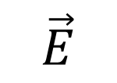

Transistor equivalent scheme
$$\vec{E}$$
$$\vec{j}$$
MOSFET has some parasitic capacities...
and resistivity

Slide 24
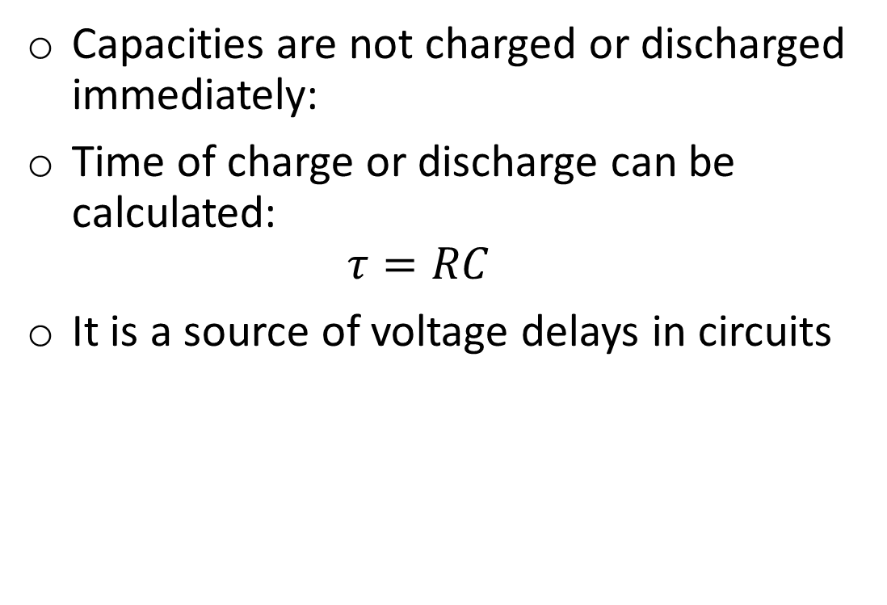
Timing
Vcc
Capacities are not charged or discharged immediately:
Time of charge or discharge can be calculated: $τ=RC$
It is a source of voltage delays in circuits
+ −
0
1
1
Output
1
1
0

Slide 25
Power Consumption in CMOS
Vcc
1
No current in static state, i.e. there is no power consumption
Current exists only at switch from one state to another to recharge the capacities
Input
Output
Input
1
0
+
+
0
Source
Gate
Drain
Drain
Gate
Source
1
-
-
n
n
p
p
p
n
No connection between the power supply and the ground
Output
Gate

Slide 26




Recharging Power
$$E_{R}=\frac{CV^{2}}{2}$$
$$E_{C}=\frac{CV^{2}}{2}$$
$$E_{R}=\frac{CV^{2}}{2}$$
$$P=CV^{2}f$$

Slide 27
Production

Slide 28
YouTube videos
“How a CPU is made“ explains how integrated circuits (IC) are created
“Intel: The Making of a Chip with 22nm/3D Transistors“ shows the whole process shortly
Steps description: From sand to silicon: the making of a chip

Slide 29
Thank You

